Slide 1
NOAA NWS report to
14th Asia Pacific Satellite Data Exchange and Utilization Meeting
26th North America-Europe Data Exchange Meeting
Fred Branski
NWS International Activities Office
International Data Exchange and Requirements Liaison
October 5, 2015

Slide 2
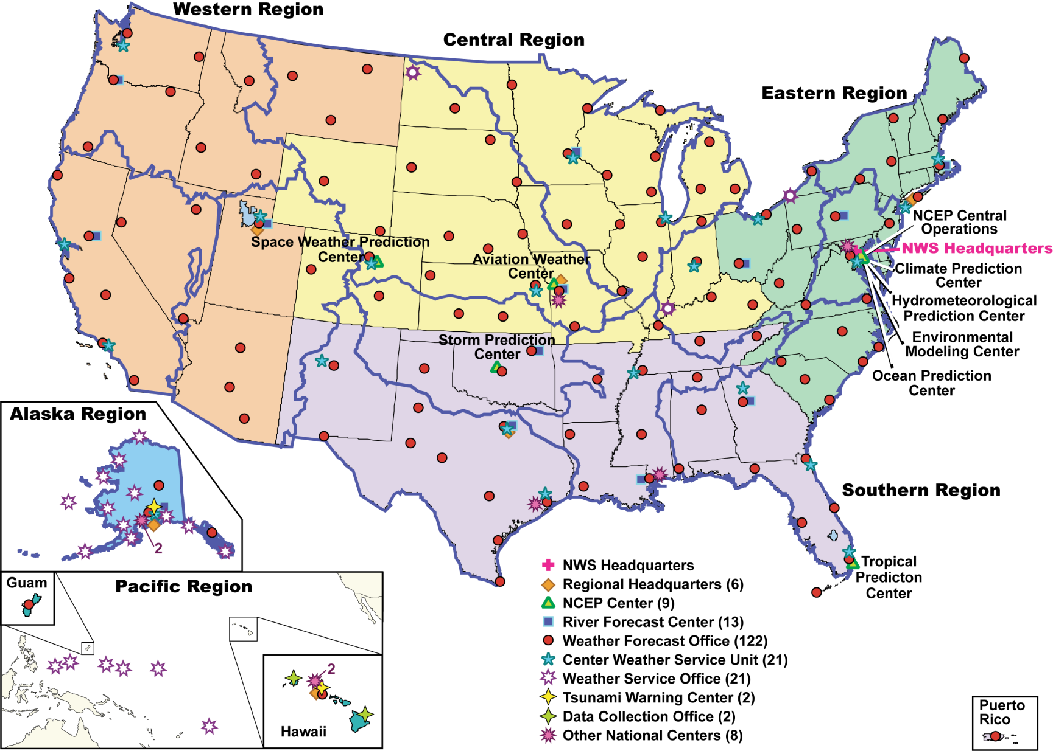
Building a Weather-Ready Nation
Notes:
*

Slide 3
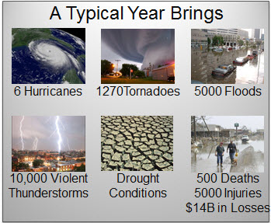
Importance of NWS Mission & Dissemination of Warnings and Forecasts
NWS provides climate, water, weather forecasts and warnings to protect life and property and enhance the economy
76 billion observations, 1.5 million forecasts, 50,000 warnings
NWS must disseminate accurate and timely forecasts and warnings
Over last year experienced
significant dissemination failures
which has put NWS mission
at risk
NOAA NWS Integrated Dissemination
Program (IDP) & NWS Dissemination
Portfolio focuses on delivering
capabilities in both short-term
and long-term
Key to capability delivery is
strong Portfolio, Program and
Project Management

Slide 4
Overview of NWS Operations

Slide 5
NWS Headquarters Restructure Around Portfolios

Slide 6
Dissemination Portfolio
Services
NWS Dissemination Portfolio consists of following five services:
Weather Warning Services
Provide timely communication of weather and non-weather related warnings directly to the public as well as emergency managers
Dissemination Infrastructure Services
Standup of operational dissemination infrastructure
Terrestrial and Satellite Networking Services
Augment and optimize NOAA’s NWS’ current
terrestrial and satellite network
Web and Geospatial Services
Leverage Web services and
Geographic Information System
(GIS) to disseminate critical
weather and environmental data
Virtualized Application Services
Provide aggregated and
consolidated critical
software applications

Slide 7
NWS Dissemination Challenges and Solutions
NWS Dissemination Portfolio and NOAA IDP
Fixing and maintaining
Delivering near-term and incremental capability and reliability upgrades
Planning and executing long-term solutions
NWS manages planned and unplanned outages on a daily basis across the nation
NWS has experienced dissemination outages with nearly national impacts during severe weather events
Technical and organizational challenges resulting from NWS Enterprise stovepipes
Highlighted need for reliable networks and dissemination systems
Diverse outages since September 2013
Government and non-government telecommunications infrastructure
NWS offices’ “last mile” single points of failures
Web capacity limitations
End of life NWS Field systems

Slide 8
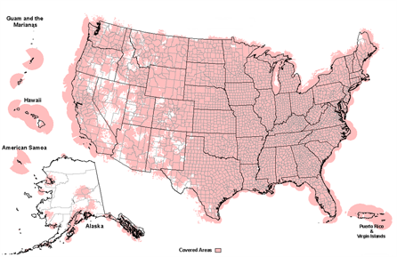
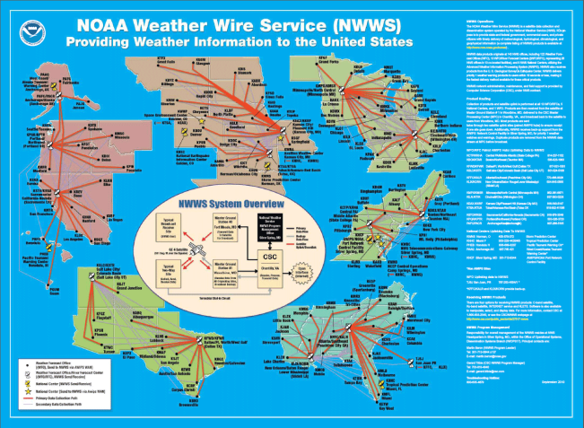
Dissemination Portfolio
Weather Warning Services
Weather Warning Services
NOAA Weather Radio (NWR)
Operates/maintains broadcast network of 1025 transmitters to provide continuous weather information from nearest NWS office
Broadcasts official warnings, watches, forecasts and other hazard information 24/7
Upgrade remaining 133 to solid state NWR transmitters
NOAA Weather Wire Service (NWWS)
Satellite data collection and redistribution system
Timely meteorological, hydrological, climatological, and geophysical information
New NWS enterprise architecture solution will be operational in FY15

Slide 9
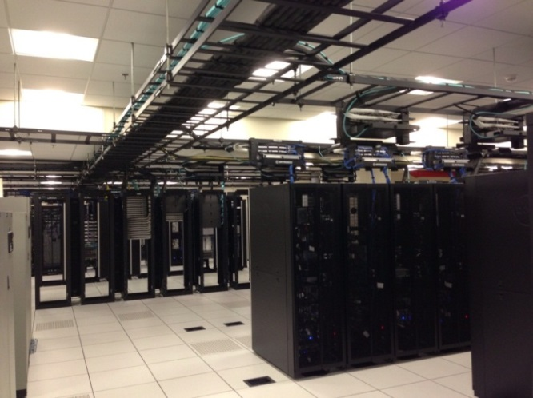
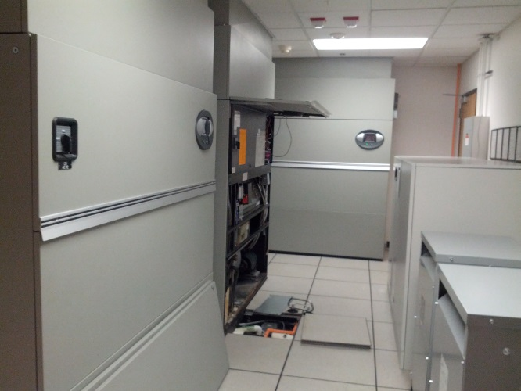
Dissemination Portfolio
Dissemination Infrastructure Services
Standup of Operational Dissemination Infrastructure
Scalable, robust, secure, and 7x24x365 operational dissemination infrastructure at the NOAA Center for Weather and Climate Prediction (NCWCP), College Park, MD, and the David Skaggs Research Center
(DSRC), Boulder, CO
Migrating critical NOAA and NWS
operational dissemination applications
including NWS Telecommunications
Gateway (NWSTG), Multi-Radar/Multi-
Sensor (MRMS), Meteorological
Assimilation Data Ingest System (MADIS),
NWS Information Dissemination System
(NIDS), and GIS
Execute termination of obsolete
dissemination programs, projects and systems
Continuous system scanning and monitoring for
security vulnerabilities and detection of security
threats or intrusions

Slide 10
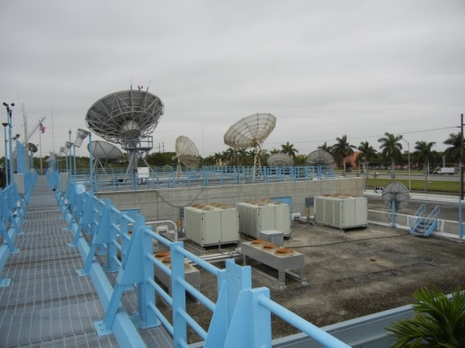
Dissemination Portfolio
Terrestrial and Satellite Networking Services
Increase Network Bandwidth and Reliability of all Offices with NWS Nationwide
Network Upgrade and Optimization
Fixing and maintaining NWS operational networks
Delivering near-term incremental capability and reliability upgrades/improvements
Planning and executing long-term upgrade to comprehensively move NWS networks to a single end-to-end managed system that is reliable and meets capacity requirements
NWS Geostationary Weather Satellite Antenna
Updating NWS geostationary downlink
antennas and ingest systems for Geostationary
Operational Environmental Satellite R-Series
Satellite Broadcast Network (SBN) Expansion
Increased NWS’ SBN from 30 to 60+ Mbps
Disseminates crucial satellite, radar and
model data to NWS field offices and to
external partners

Slide 11
Dissemination Portfolio
Web and Geospatial Services
Standup and Maintain an Enterprise GIS Infrastructure
Leveraging web services and GIS to disseminate NOAA and NWS critical data to forecasters, NOAA users, Federal partners (Federal Aviation Administration (FAA) and Federal Emergency Management Agency (FEMA)), International community and public
Implementing net-centric weather information dissemination capability to fulfill NWS’ role in the Congressionally mandated Next Generation Air Traffic System (NextGen) directive
Onboarding current GIS capabilities on an operational dissemination infrastructure
Establishing common format framework for
operating GIS data sets
Establishing consistent metadata and a consolidated
catalog for discovery and access of NOAA and NWS
geospatial content

Slide 12
Dissemination Portfolio Way Forward/Next Steps
Fixing and maintaining
Upgrading 133 of 1025 NWR transmitters to solid state transmitters
Delivering near-term and incremental upgrades
Robust and reliable 7x24 operational IDP dissemination infrastructure in two geographical diverse locations
Upgrading NWS networks for 4-50 times increases in Internet bandwidth
Operationalizing enterprise GIS services
GOES-R installation upgrades and ground readiness
Planning and executing long-term solutions
Transition www.weather.gov and other NWS websites to operational IDP dissemination infrastructure
100% backup dissemination capabilities with increased capacity to meet growing demands for NWS environmental products
Conduct a comprehensive network audit of 140 NWS Field Offices to inform planned acquisitions for to-be NWS network and single points of failures
Single end-to-end managed network that is reliable and meets capacity requirements

Slide 13
WIS GISC Washington status as of September 2015
GISC Washington operational since May 2013
GISC Discovery–Access-Retrieval (DAR) system implemented under OpenWIS
GISC Core staff participating in WIS and OpenWIS committees
Development of WIS metadata generator nearing completion
RA-IV WIS Implementation Plan under development
WIS Metadata training conducted as part of WMO Region IV WIS Workshop held 10 – 13 August 2015

Slide 14
WIS GISC Washington status as of September 2015
Currently supporting 19 registered users, 3 DCPCs, and 26 NCs
Routine Metadata Synchronization with majority of Operational GISCs
All GTS products received by GISC Washington are in the 24 Hour Cache.
GISC backup arrangement with Brazil under development
Telecommunication Operations Center no more,
now NCEP Central Operations – Silver Spring (NCO-SS)

Slide 15
WIS GISC Washington Next Steps Moving Forward
Implementation of WIS Dashboard
Implementation the WIS DAR in virtualized environment
Begin formulation of WIS GISC Washington plan for integration with WIGOS, and the migration/transition to WMO cloud architecture.

Slide 16
Incoming RMDCN to USA

Slide 17
Outgoing RMDCN from USA

Slide 18
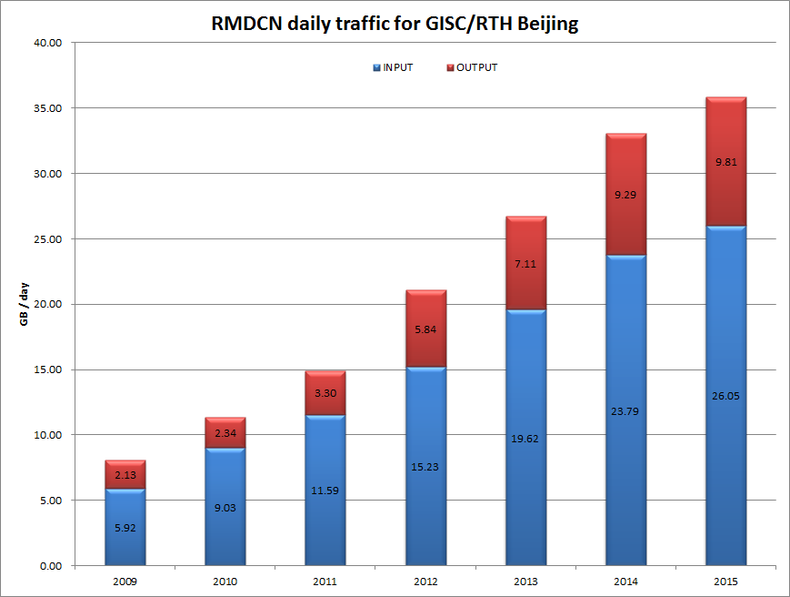
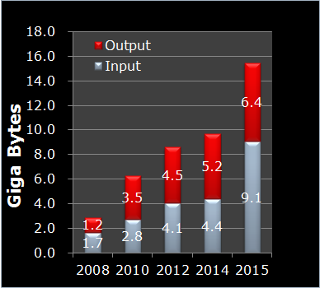
RMDCN Evolution
Growth rate:
60-110% per year
500-900% in 8 years
Is this sustainable???
Japan RMDCN

Slide 19
Thank You / Discussion
Thank you!
Discussion ???

